Slide 1
Surveying Engineering
Dr Nada Kadhim
Diyala School of Engineering
University of Diyala
Second Stage
14/10/2018

Slide 2
References:
Introduction to surveying
James M. Anderson & Edward M. Mikhail, 1985
Surveying
A. Bannister & S. Raymond, 1984
Surveying, theory and practice
James M. Anderson & Edward M. Mikhail, seventh Edition, 1998
Elementary surveying : an introduction to geomatics
Charles D. Ghilani, Paul R. Wolf. - 12th ed.

Slide 3
Introduction
Definitions
Types of surveying
Elementary surveying & the use of surveying
Units of measurements

Slide 4
Definitions
Surveying: the art of making measurements of the relative positions of natural and man-made features on the earth’s surface, and the presentation of this information either graphically or numerically.
Surveying is divided primarily into geodetic surveying and plane surveying.
In geodetic surveying large areas of the earth’s surface are involved and the curvature of the earth must be taken into account.
In plane surveying relatively small areas are under consideration and it is taken that the earth’s surface is flat, i.e. it gives a horizontal plane.

Slide 5
Definitions
Plane surveys are the most commonly practised method of surveying and treat the earth as a flat or "plane" surface. Good enough for small-scalesurveys in limited areas, the curvature of the earth has no effect on the results, thus the computations and results can be referenced to a plane or flat surface.
Geodetic surveys are a branch of surveying. Frameworks of angular and distance measurements between points are necessary to control all surveys and when surveying large areas, such as a whole country, these measurements must be taken to the highest possible standard. Modern methods for this task include global positioning system (GPS) which use transmission from satellites to obtain the three dimensional co-ordinates of any point on the earth’s surface to a high degree of accuracy. The study of the size and shape of the earth and its gravity field is known as geodesy, hence the name of this type of surveying.

Slide 6
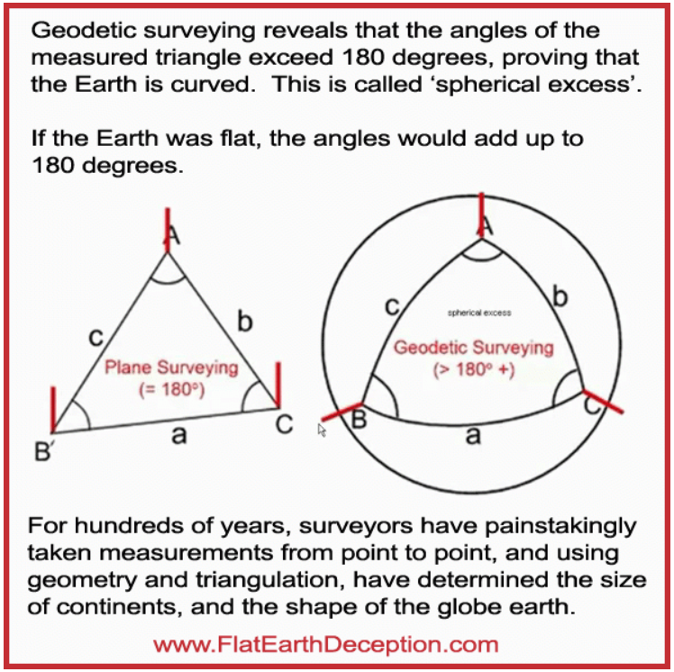

Slide 7
A vertical line at any point on the earth’s surface is the line that follows the direction of gravity that point
A horizontal line at a point is any line that is perpendicular to the vertical line at the point. At any point there are an unlimited number of horizontal lines
A horizontal plane at a point is the plane that is perpendicular to the vertical line at the point
A vertical plane at a point is any plane that contains the vertical line at the point. There are an unlimited number of vertical planes at a given point
A level surface is a continuous surface that is at all points perpendicular to the direction of gravity. It is exemplified by the surface of a large body of water complete rest (unaffected by tidal action)
A horizontal distance between two given points is the distance between the points projected onto a horizontal plane.
A horizontal angle is an angle measured in a horizontal plane between two vertical planes.

Slide 8
A vertical angle is an angle measured in a vertical plane. By convention, if the angle is measured upward from a horizontal line or plane, it is referred to as a plus or positive vertical angle, and also as an elevation angle. If the angle is measured downward, it is referred to as a minus or negative vertical angle, and also as a depression angle.
A zenith angle is also an angle measured in a vertical plane, except that, unlike a vertical angle, the zenith angle is measured down from the upward direction of the plumb line.
The elevation of a point is its vertical distance above or below a given reference level surface.
The difference in elevation between two points is the vertical distance between two level surfaces containing the two points.

Slide 10
Types of surveying
Surveys are often classified by purpose, as follows.
Topographic surveys
These produce maps and plans of the natural and man-made features.
A plan detail is drawn such that it is true to scale, whilst in a map many features have to be represented by symbols, the scale being too small.
Plans tend to be used for engineering design and administration purposes only, but maps have a multitude of uses: navigational, recreational, geographical, geological, military, exploration – their scales ranging from 1:25,000 to, say 1:1000,000
Engineering surveys
These include all the survey work required before, during and after any engineering works.
For the design and construction of new routes, e.g. roads and railways, but in many other aspects of surveying, it is required to calculate the areas and volumes of land and for setting out curves for route alignment.

Slide 11
Typical scales are as follows:
Architectural work, building work, location drawings: 1/50, 1/100, 1/200.
Site plans, civil engineering works: 1/500, 1/1000, 1/1500, 1/2000, 1/2500.
Town surveys, highway surveys: 1/1250, 1/2000, 1/2500, 1/5000, 1/10,000, 1/20,000, 1/50,000.
Cadastral surveys
These are undertaken to produce plans of property boundaries for legal purposes. In many countries the registration of ownership of land is based on such plans.
Assignment (1):
Give a proper definition to the following expressions:
Photogrammetry, Cartography, Mine surveying, and Hydrographic survey

Slide 12
Elementary surveying & the use of surveying
The surface of the earth over any construction site is really only a collection of points lying at different heights.
The objective of a survey is to take sufficient measurements, linear and/or angular, to relate any one unknown point to any two other known points.
Since all points lie at different elevations, distances measured between them will not be horizontal. These distances are called slope lengths. They can be converted to their horizontal equivalents very easily.
The relative positions of the points can be fixed in a number of ways, depending largely upon the area covered by the points.

Slide 13
In Figure (1), the area is small and can be surveyed by using linear measurements only.
In Figure (2), the area is much larger in extent and angle measurements would be required.
Z
Telephone pole
Z
river
X
90˚
Y
X
Y
O
kerb
Figure (1)
Figure (2)

Slide 14
(a) Using linear methods only
Linear survey: the measurements of three sides XY, YZ, and XZ
Lines at right angles (offsetting): the measurement of a line OZ exactly at right angle with XO and OY
(b) Using linear and angular methods
Triangulation: the measurements of a baseline XY, and two angles ZXY and XYZ
Polar coordinates (traversing): the measurements of two lines XZ and XY, and one angle ZXY
(c) Applications of principles
The methods above can be used in making a site survey, e.g. house and garden covering about one hectare of ground, which would be considered to be a medium sized site.

Slide 15
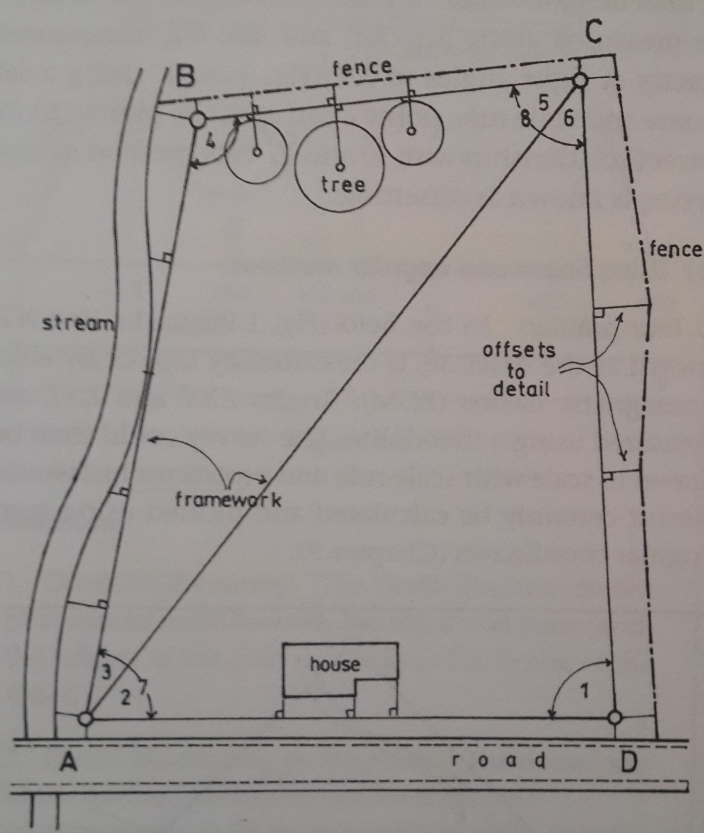

Slide 16
This survey is carried out in two parts, (1) a framework and (2) a detail, survey.
Framework survey
The framework is first established over the whole site to form a sound geometrical figure and is carried out using one of the following methods:
Linear survey: the triangle ABC and ACD
Triangulation: the angles 1,2,3,4,5 and 6, and one side of the survey AD
Traversing: the angles 1,7,4 and 8 with the lengths of sides DA, AB, BC and CD
Detail survey
The fences, stream, buildings and path are the details which are added to the framework survey by means of offsets, which are short lines at right angles to the main framework lines.
Alternatively, detail can be added to a framework survey by means of electromagnetic distance measurements (EDM) tacheometry or the global positioning system (GPS)

Slide 17
All surveys are conducted in this manner, i.e. a two-stage process in which the whole area is covered by a framework within which the detail is added. This ensures that the survey rule of ‘working from the whole to the part’ is obeyed.
Assignment (2):
The following figure, A and B lie at different elevations. The slope length along line AB is 50.00 m and the angle of slope is 10˚. Calculate the horizontal length AC and the difference in height BC, between the points.
B
50.00 m
10˚
A
C

Slide 18
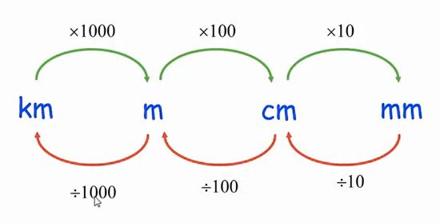
Units of measurements

Slide 19
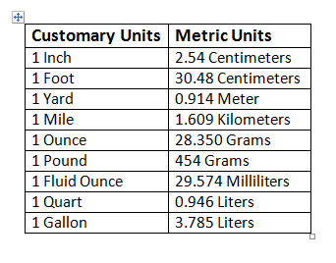
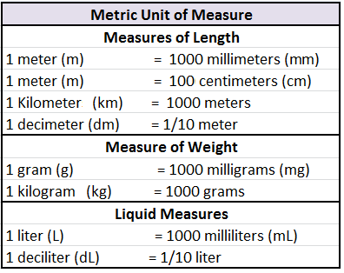

Slide 21
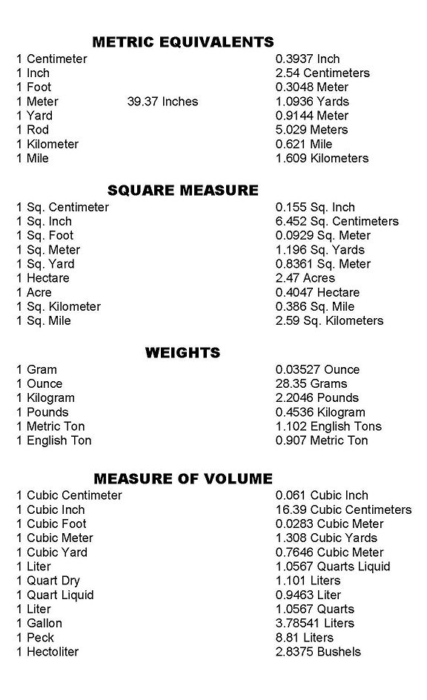

Slide 23
Assignment (3):
In surveying , angles have to add or subtract frequently. Their values are written in sexagesimal form as follows:
10 degs, 23 mins, 18 secs =

